Slide 1
Optimizing Health Risk Predictions with AI and Data Accuracy
Varshitha Reddy DAvarapalli
KARUNAKAR UPPALAPATI
Group 2

Slide 2

Optimizing Health Risk Predictions with AI and Data Accuracy
Integrating AI into Clinical Decision Support Systems
Project Focus: Enhancing healthcare predictions by improving patient data quality in Electronic Health Records (EHRs).
Key Objective: Providing reliable, personalized health insights through advanced machine learning models.
Significance: Transforming patient care with accurate risk assessments and real-time decision-making support.

Slide 3
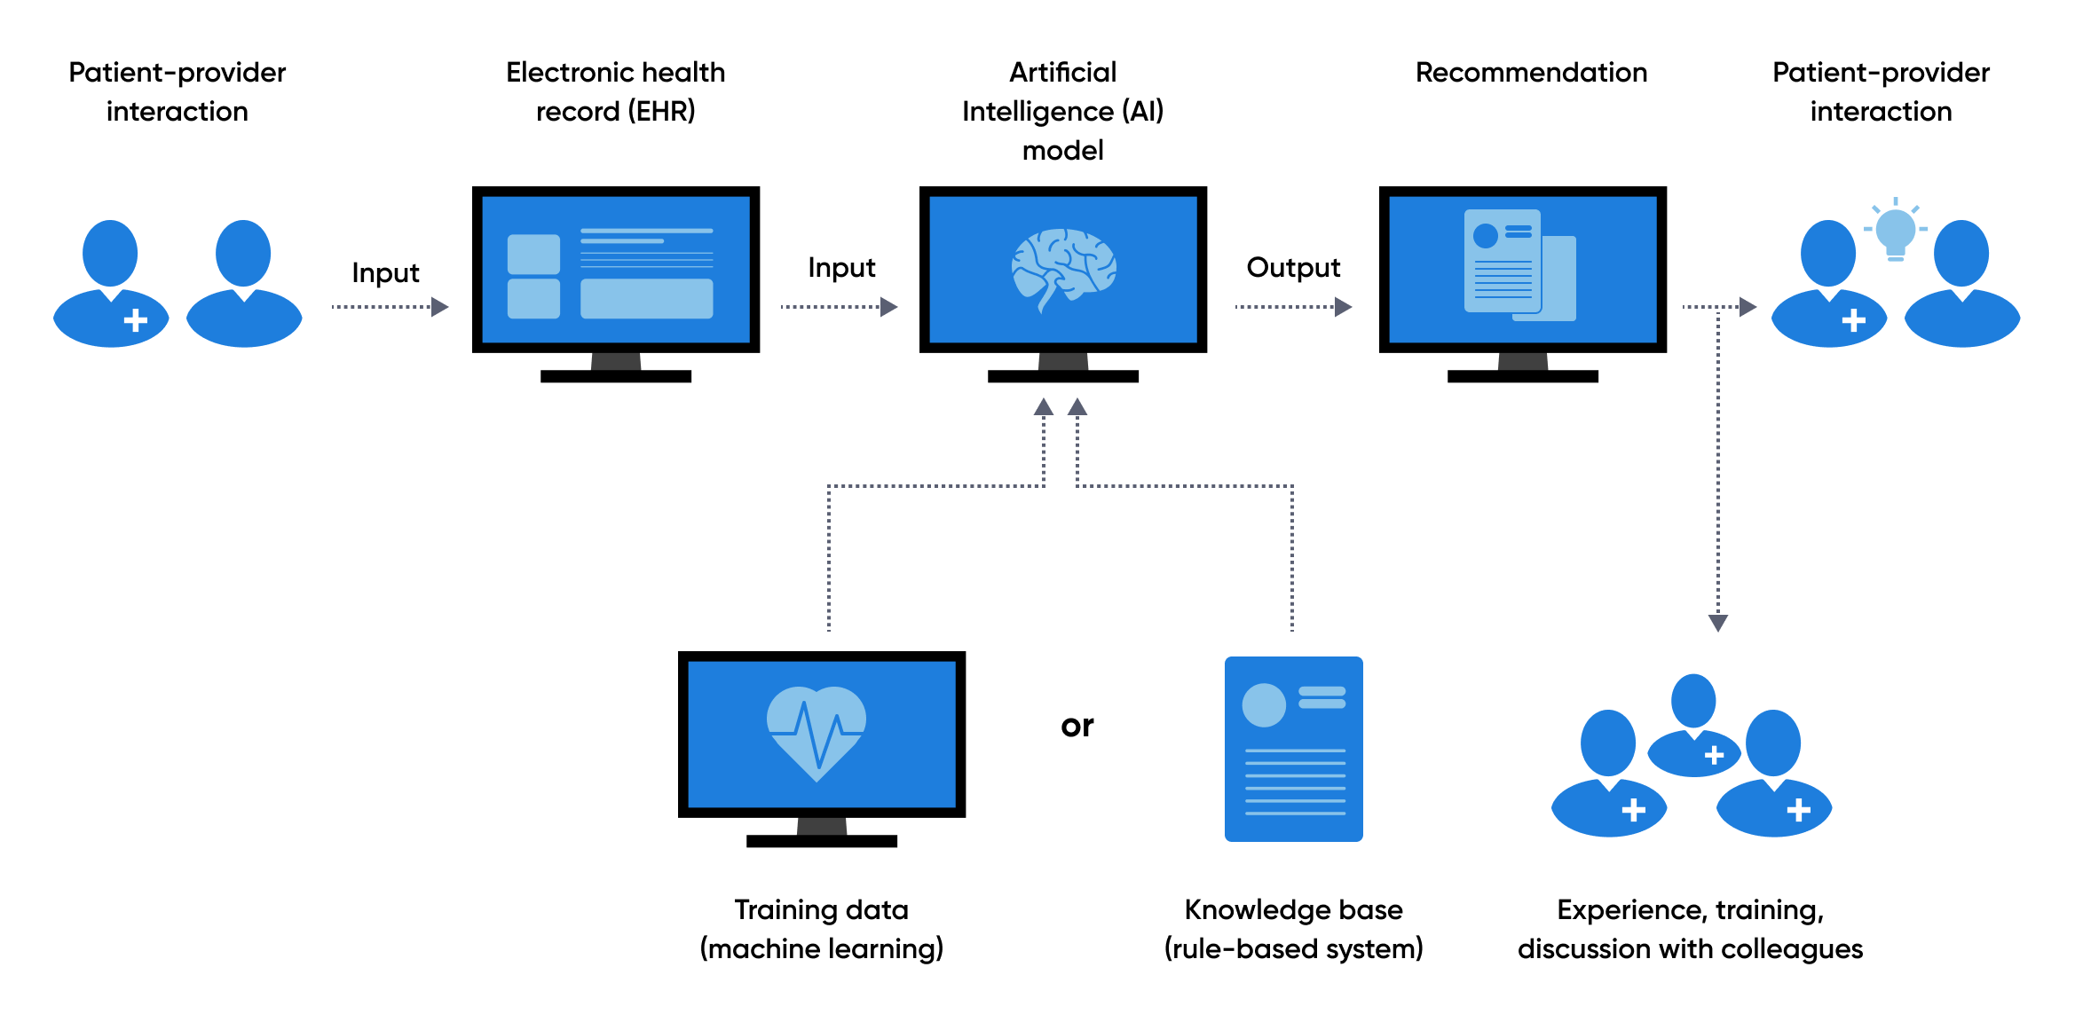

Slide 4
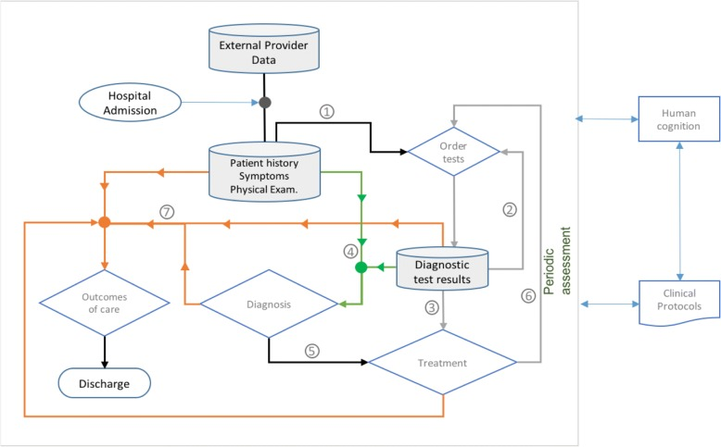

Slide 5
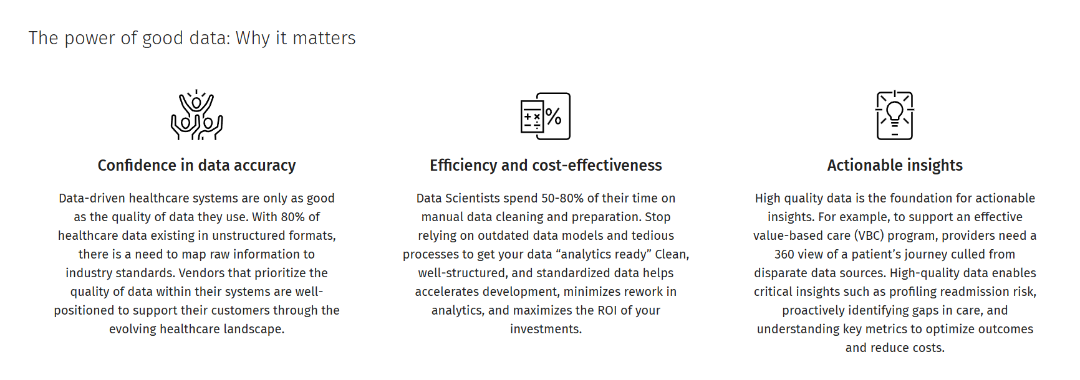
"A Survey on Deep Learning Techniques for Predictive Analytics in Healthcare"
Authors: S. R. Pfohl, A. Foryciarz, and N. H. Shah
Published: 2024

Slide 6
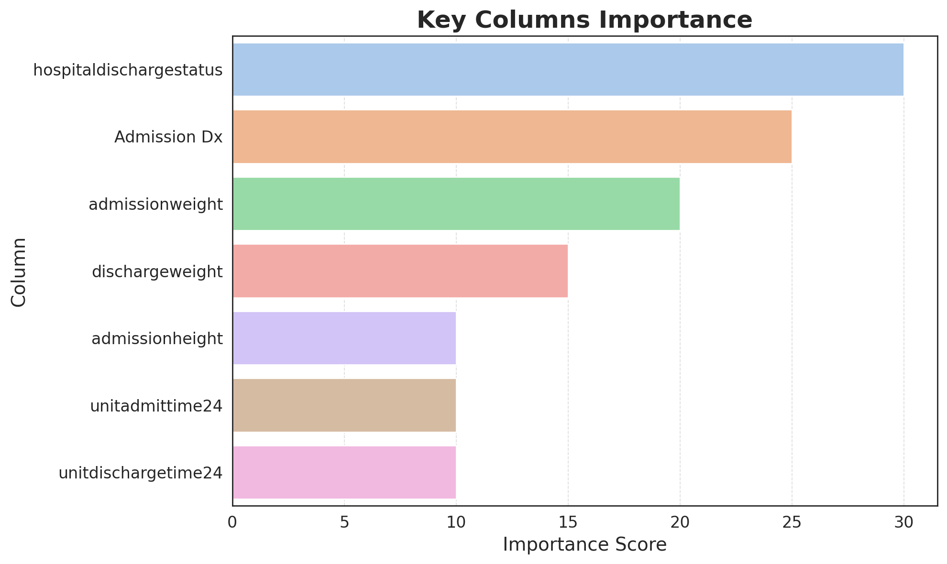
DATASET OVERVIEW

Slide 7
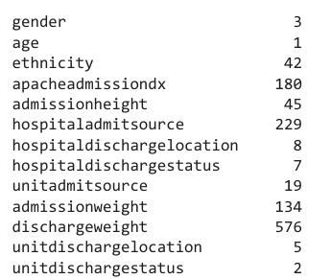
Data Preprocessing and Cleaning
Ensuring Data Quality in EHR Systems
MISSING VALUES
Handling Missing Values: Applied mean and mode imputation for numerical and categorical variables to ensure data completeness.
Outlier Detection: Used Z-score method to identify and minimize the impact of outliers on model performance.
Categorical data: feature encoding was applied using one-hot encoding to convert categorical variables into numerical format
Numerical data:Standardization was performed using StandardScaler to scale numerical features, ensuring they have a mean of 0 and a standard deviation of 1.

Slide 8
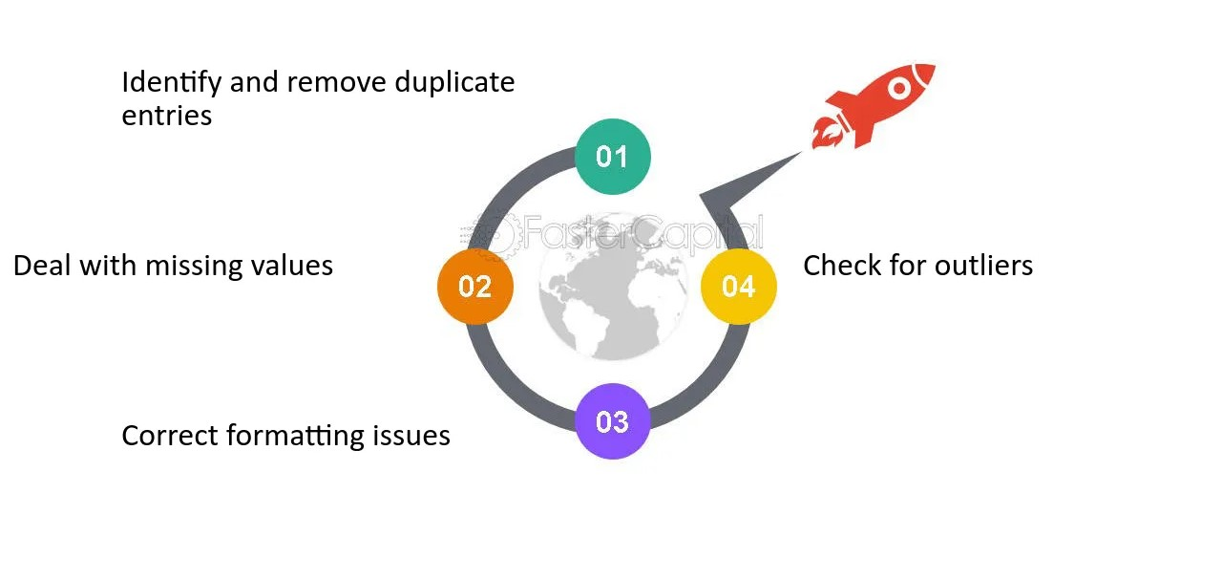
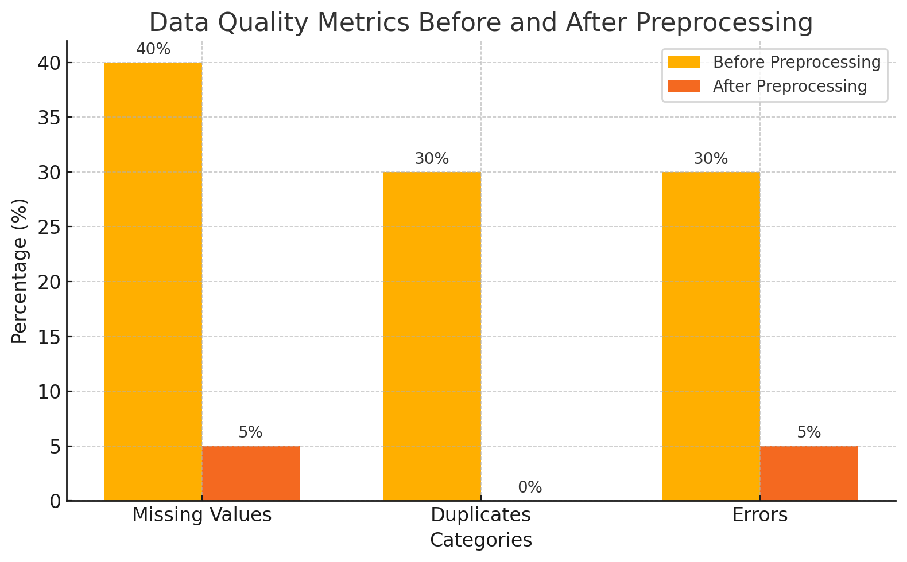

Slide 9

Feature Engineering and Model Building
Enhancing Predictive Accuracy with Advanced Techniques
Feature Engineering: Developed new variables like hospital stay duration and combined clinical attributes for a richer predictive context.
Machine Learning Models: ImplementedLogistic Regression, Decision Trees, and Neural Networks to capture diverse data patterns.
Balancing Classes: Addressed class imbalances using SMOTE to improve model fairness and sensitivity.

Slide 10
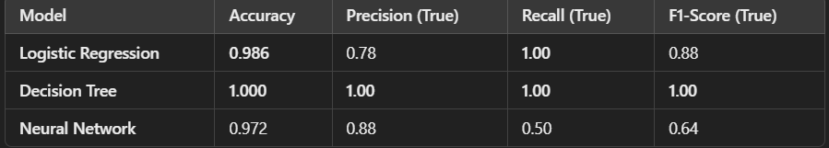
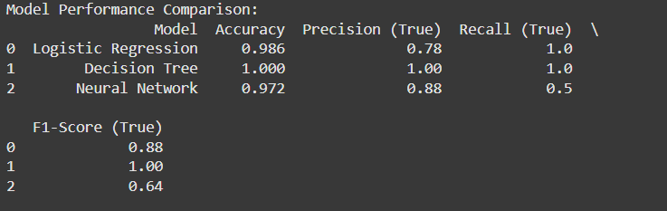
Machine Learning Models performance comparison
Observations
Logistic Regression: High overall performance with 98.6% accuracy and strong metrics for predicting True (expired).Strengths: Perfect recall for True cases (no false negatives).Weaknesses: Slightly lower precision (78%) for predicting True.
Decision Tree: Perfect performance across all metrics (accuracy, precision, recall, F1-score).Strengths: Successfully identifies all cases (True and False) with no errors.Weaknesses: While perfect scores might indicate good performance, this could be a sign of overfitting, especially with small datasets.
Neural Network:High accuracy (97.2%) and strong precision for True (expired) cases (88%).Strengths: Excellent precision for critical predictions.Weaknesses: Lower recall (50%) and F1-score (64%) for predicting True cases, meaning it misses many expired cases.

Slide 11
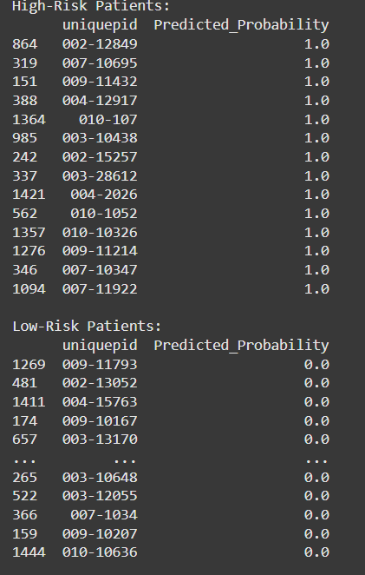
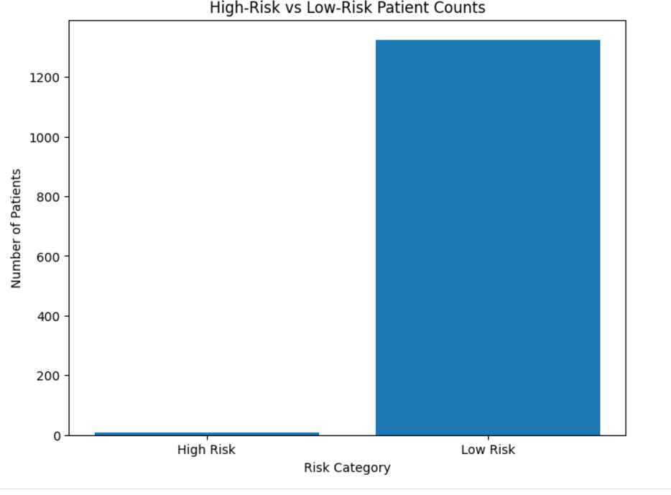
Results and Analysis

Slide 12
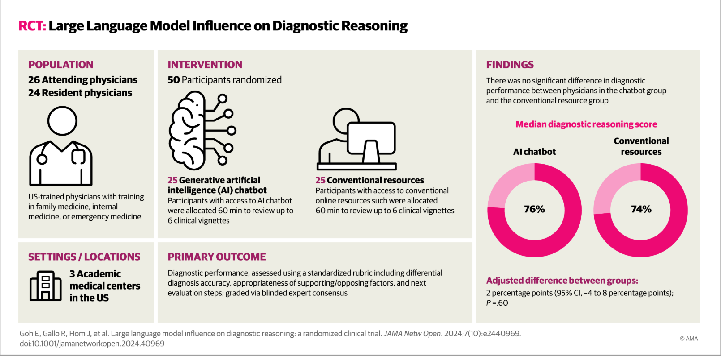
Innovation and impact
Large Language Model Influence on Diagnostic ReasoningA Randomized Clinical Trial
Ethan Goh, MBBS, MS^{1,2}; Robert Gallo, MD³; Jason Hom, MD⁴; et al

Slide 13
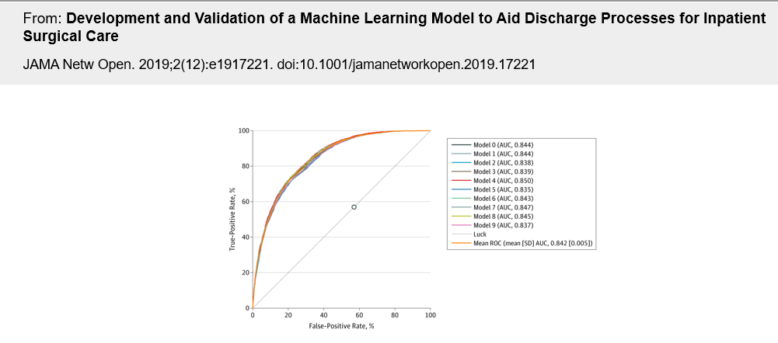
The models help predict the length of stay (LOS) and improve hospital discharge planning.
Receiver Operating Characteristic (ROC) Curve:ROC Curve is a tool used to evaluate the performance of binary classification models. It plots the True Positive Rate (sensitivity) against the False Positive Rate (1 - specificity).
The AUC (Area Under the Curve) is a metric derived from the ROC curve, representing the model's ability to distinguish between the positive and negative classes. A higher AUC indicates a better-performing model.AUC for Each Model:The slide displays the AUC for several models:Model 0 (AUC: 0.844)Model 1 (AUC: 0.844)Model 2 (AUC: 0.838)... and so on.

Slide 14
Challenges and Limitations:
Our study has some limitations. The model was trained and validated on patients within a single institution; thus, its generalizability to other hospitals is uncertain.
Data Quality Issues:
Incomplete, inconsistent, or erroneous Electronic Health Records (EHRs) data impacts model accuracy.
Noise and outliers require extensive preprocessing.
Class Imbalance:
Significant class imbalances in health outcomes lead to biased predictions, requiring techniques like SMOTE.
Feature Complexity:
High dimensionality and dependency among features increase the risk of overfitting in complex models.
Integration Challenges:
Difficulty in integrating AI tools seamlessly into existing Clinical Decision Support Systems (CDSS).
Scalability:
Challenges in scaling models for large healthcare datasets while maintaining real-time performance.

Slide 15
References:
Kotschenreuther , K. (2024). EHR-DS-QA: A Synthetic QA Dataset Derived from Medical Discharge Summaries for Enhanced Medical Information Retrieval Systems (version 1.0.0). PhysioNet.
Chen, J., Sun, Y., Chen, X., & Chen, L. (2019). Clinical data mining in healthcare: A comprehensive review. Journal of Medical Systems, 43(4), 77-89.
Katz, G. E., Butte, A. J., & Ghassemi, M. (2019). The importance of feature engineering in healthcare data science. Journal of C linical Informatics, 15(3), 45-54.
Troyanskaya, O., Cantor, M., Sherlock, G., Brown, P., Hastie, T., Tibshirani, R., & Botstein, D. (2001). Missing value estimation methods for DNA microarrays. Bioinformatics, 17(6), 520-525.
X. Doe, et al. Machine Learning in Clinical Decision Support: Current Trends and Challenges. Journal of Healthcare Informatics, 2022.
A. Smith, et al. The Role of NLP in Enhancing CDS Systems. Medical Data Analysis, 2021.
R. Chen, et al. Explainable AI in Healthcare: A Comprehensive Review. Journal of AI in Medicine, 2023.

Slide 16

Conclusion :
Developed accurate AI models for predicting health risks, utilizing Logistic Regression, Decision Trees, and Neural Networks. Focused on robust data preprocessing and feature engineering to enhance model performance. The project showcases the potential of AI in improving clinical decision-making and paves the way for future integration with real-time healthcare systems.

